Slide 1
ENGR 102 PROGRAMMING PRACTICE
WEEK 7

Slide 2

Making Recommendations

Slide 3
Collaborative Filtering
A collaborative filtering algorithm usually works by
searching a large group of people, and
finding a smaller set with tastes similar to yours.
looking at other things they like and combining them to create a ranked list of suggestions.

Slide 4
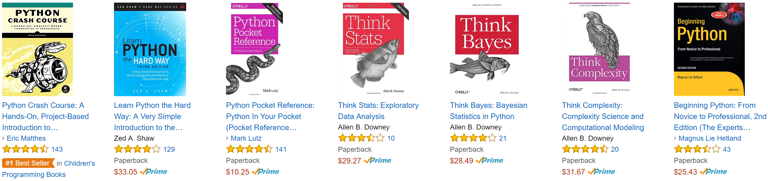
Matching Products
Now you know how to find similar people and recommend products.
What if you want to see which products are similar to each other?
How would you do it?

Slide 5
Matching Products
looking at what items a particular person liked
seeing the other people who liked the same things
Determine similarity by
looking at who liked a particular item and
seeing the other things they liked.

Slide 6
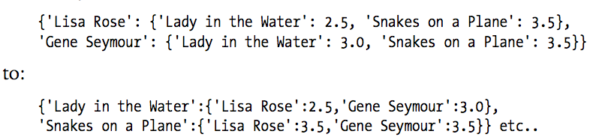
Matching Products transformPrefs(…)
Just need to swap the people (i.e., critics) and the items (i.e., movies).

Slide 7
Matching Products transformPrefs(…)
The following function performs the necessary transformation:
def transformPrefs(prefs): result = {} for person in prefs: for item in prefs[person]: result.setdefault(item, {}) result[item][person] = prefs[person][item] return result

Slide 8
Matching Products transformPrefs(…)
from recommendations import * movies = transformPrefs(critics) print(topMatches(movies, 'Superman Returns'))

Slide 9
Matching Products Another Motivation
Switching the products and people would allow to search for people who might buy certain products.
Planning a marketing effort for a clearance day.
New links on a link-recommendation site are seen by the people who are most likely to enjoy them.

Slide 10
Recommending Watchers for Movies
from recommendations import * movies = transformPrefs(critics) print(getRecommendations(movies, ‘Just My Luck'))

Slide 11
Structuring & Visualization
Notes:
Last week, we discussed ways to find things that are closely related, so, for example, you could find someone who shares your taste in movies. In this new topic, we will expand on those ideas and introduce data clustering, a method for discovering and visualizing groups of things, people, or ideas that are all closely related. In this part of the class, you’ll learn: how to prepare data from a variety of sources;
two different clustering algorithms;
more on distance metrics;
simple graphical visualization code for viewing the generated groups; and finally,
a method for projecting very complicated datasets into two dimensions.

Slide 12
Clustering
Retailers: track customer purchases
Detect groups of customers with similar buying patterns.
“fashion islands”: develop a marketing strategy
Computational biology
Find groups of genes that exhibit similar behavior
respond to a treatment in the same way
part of the same biological pathway

Slide 13
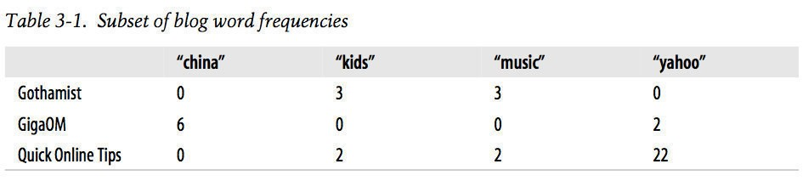
Example
Notes:
Since this book is about collective intelligence, the examples in this chapter come from sources in which many people contribute different information. The first example will look at blogs, the topics they discuss, and their particular word usage to show that blogs can be grouped according to their text and that words can be grouped by their usage. The second example will look at a community site where people list things they own and things they would like to own, and we will use this information to show how people’s desires can be grouped into clusters.

Slide 14
Preprocessing
Almost all blogs can be read online or via their RSS feeds.
RSS: Really Simple Syndication
specially formatted web document
contains information about a blog and all the contained entries.
The ﬁrst step in generating word counts for each blog is to parse these feeds.
Feed Parser is an excellent module.

Slide 15
Install feedparser
PyCharm (like any other module installation)
or
pip install feedparser

Slide 16
Sample Data Set
Highly referenced blogs with clean data (mostly text)
feedlist.txt
Available on LMS (/Week 07)

Slide 17
RSS Feed
RSS feeds always have a title and a list of entries.
Each entry usually has either a summary or description tag that contains the actual text of the entries.

Slide 18
Get word counts
# Returns title and dictionary of word counts for an RSS feed def getwordcounts(url): # Parse the feed print('processing', url) d = feedparser.parse(url) wc = {} # Loop over all the entries for e in d.entries: if 'summary' in e: summary = e.summary else: summary = e.description # Extract a list of words words = getwords(e.title + ' ' + summary) for word in words: wc.setdefault(word, 0) wc[word] += 1 try: return d.feed.title, wc except AttributeError: return None, None

Slide 19
Tokenize: Get Words
import re # Strips out all of the HTML and splits the words by nonalphabetical # characters and returns them as a list. def getwords(html):
# Remove all the HTML tags txt = re.compile(r'<[^>]+>').sub('',html) # Split words by all non-alpha characters words = re.compile(r'[^A-Z^a-z]+').split(txt) # Convert to lowercase return [word.lower() for word in words if word != '']

Slide 20
Generate word counts
apcount = {} wordcounts = {} feedlist = [] with open('feedlist.txt') as feedurls: for feedurl in feedurls: title, wc = getwordcounts(feedurl) if title != None: print('\t has some content') feedlist.append(feedurl) wordcounts[title] = wc for word,count in wc.items(): apcount.setdefault(word,0) if count>1: apcount[word]+=1 else: print('\t skipped - no title') wordlist=[] for w,bc in apcount.items(): frac=float(bc)/len(feedlist) if frac > 0.1 and frac < 0.5: wordlist.append(w)
Compute word appearance counts
Eliminate common & rare words

Slide 21
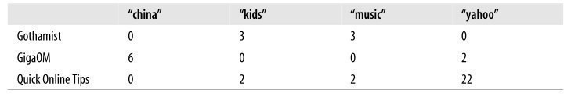
Create word matrix
with open('blogdata.txt','w') as out: out.write('Blog') for word in wordlist: out.write('\t%s' % word) out.write('\n') for blog,wc in wordcounts.items(): # in case there are non ascii blog texts blog = blog.encode('ascii','ignore').decode('ascii') out.write(blog) for word in wordlist: if word in wc: out.write('\t%d' % wc[word]) else: out.write('\t0') out.write('\n')

Slide 22
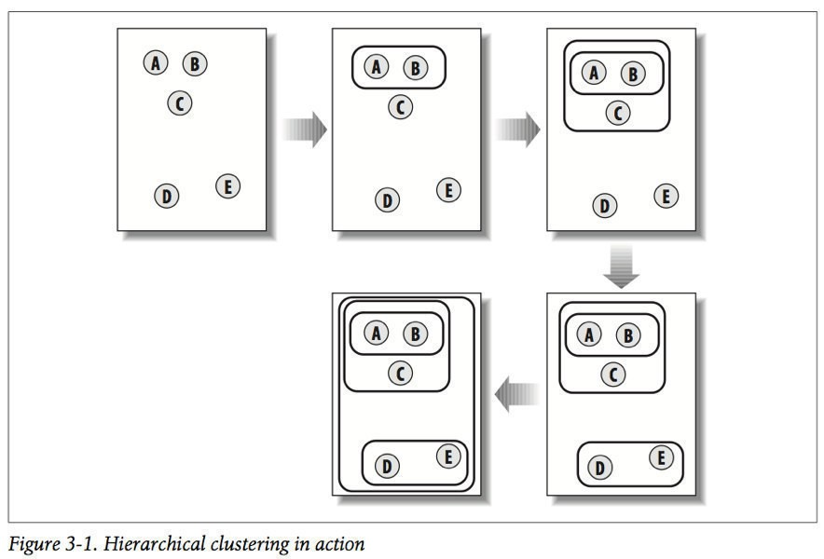

Hierarchical Clustering

Slide 23

Hierarchical Clustering

Slide 24
Hierarchical Clustering

Slide 25

Hierarchical Clustering

Slide 26

Hierarchical Clustering

Slide 27
Similarity (closeness)
Pearson correlation coefﬁcient.
Others can be used as well.
e.g., Jaccard (|intersection| / |union|) (a.k.a. Tanimoto)

